Slide 1
IDB - Genome annotation
29/03/20202
JD Martin
Post Doc

Slide 2
Whole genome sequencing
Analysis of all genetic material of a cell/culture/microcosm
Allows for the association of biological implications
The annotation, characterization, and comparison of genomes can aid in better understanding:
microbial evolution
taxonomic classification
metabolic potential

Slide 3
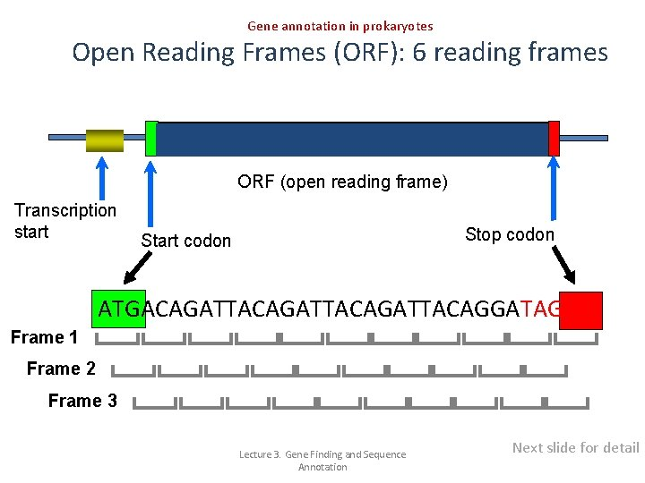
Genome Annotation
Process of identifying functional elements along the sequence of a genome
nucleotide-level annotation
identify physical location genes, RNAs, and repetitive elements
Protein-level annotation
determine the possible functions of genes
Process-level annotation
identify the pathways and processes in which different genes interact
Programs: Prokka, RAST, etc.
Notes:
Genome annotation can be divided into three basic categories. The first is a nucleotide-level annotation, which seeks to identify the physical location of DNA sequences to determine where components such as genes, RNAs, and repetitive elements are located. Sequencing and/or assembly errors at this stage can result in false pseudogenes through indels. The second is a protein-level annotation, which seeks to determine the possible functions of genes, identifying which one a given organism does or does not have. The third is a process-level annotation, which aims to identify the pathways and processes in which different genes interact, assembling an efficient functional annotation. In the last two levels, sequencing and/or assembly errors may compromise the inference of the true gene function because of reduced similarity (Miller et al., 2010; Reeves et al., 2009; Stein, 2001).

Slide 4

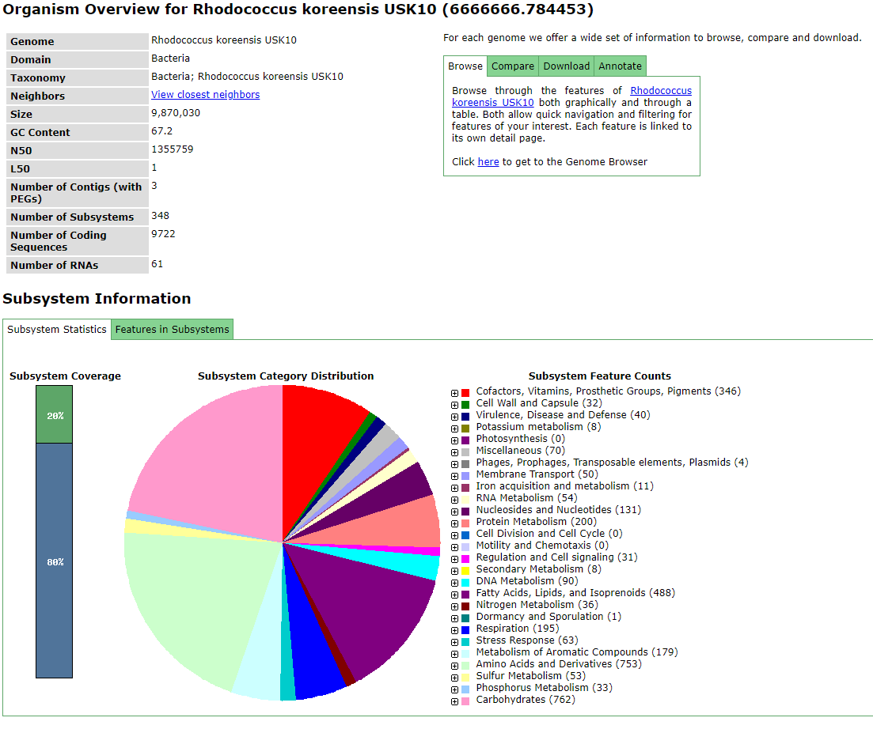
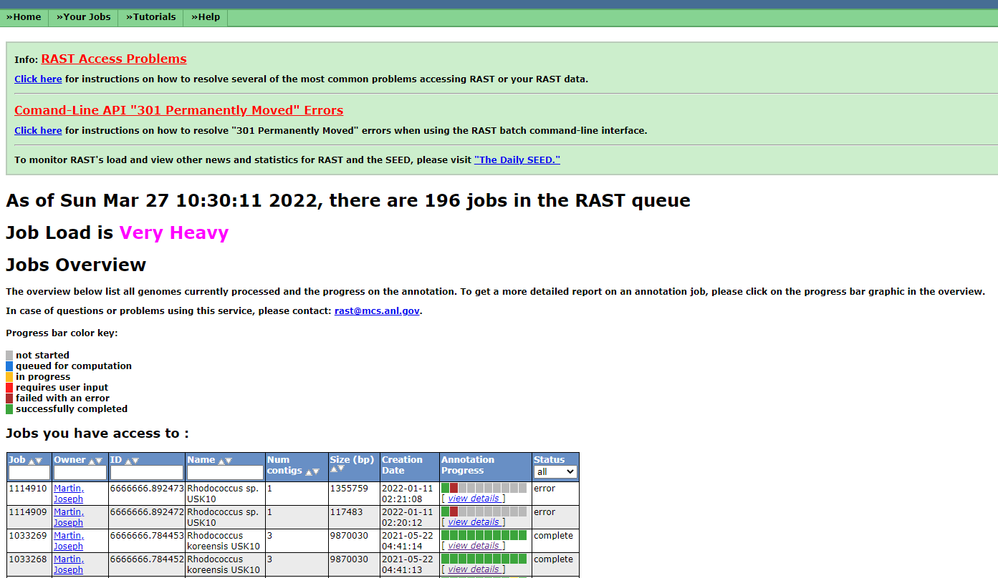
RAST

Slide 5
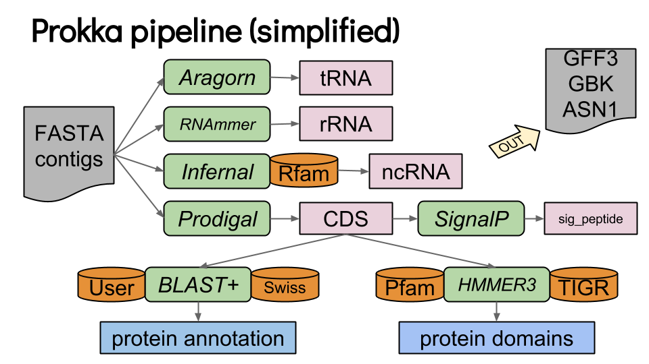
Prokka
Notes:
A protein domain is a region of the protein's polypeptide chain that is self-stabilizing and that folds independently from the rest. Each domain forms a compact folded three-dimensional structure. Many proteins consist of several domains.

Slide 6
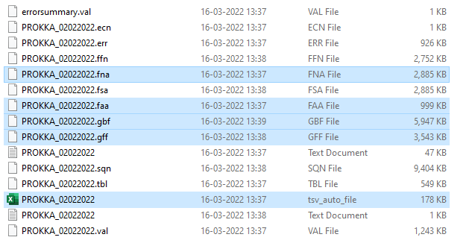
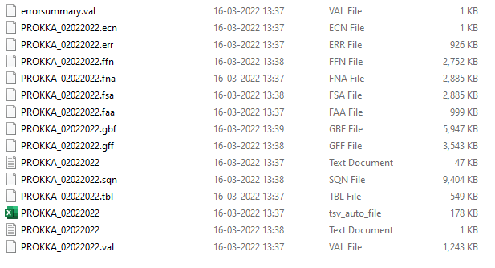
Output:
.fna
Fasta file
.faa
Proteins sequences
.gbf
GenBank format
.gff
Generic feature format
Excel file containing all annotations
Notes:
The GFF and GBK files contain all of the information about the features annotated (in different formats.)
The .txt file contains a summary of the number of features annotated.
The .faa file contains the protein sequences of the genes annotated.
The .ffn file contains the nucleotide sequences of the genes annotated.

Slide 7
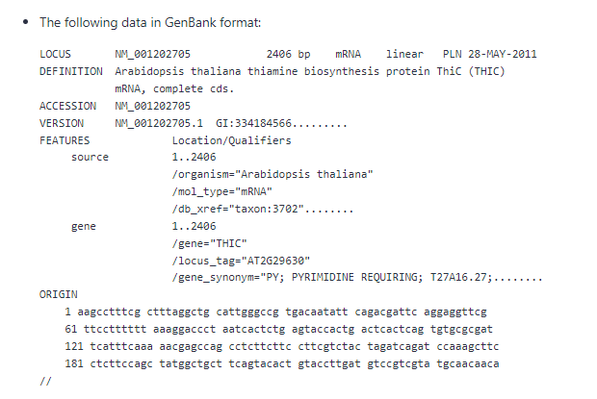
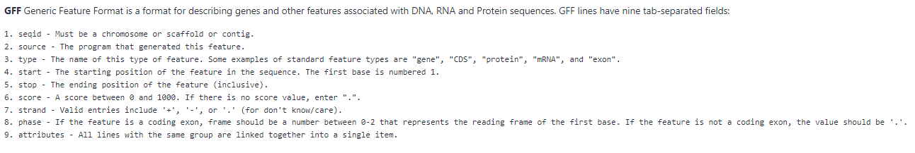
Output: .gbf vs. .gff

Slide 8



Geneious
Suite of tools for molecular biology and NGS tools
Alternatives:

Slide 9
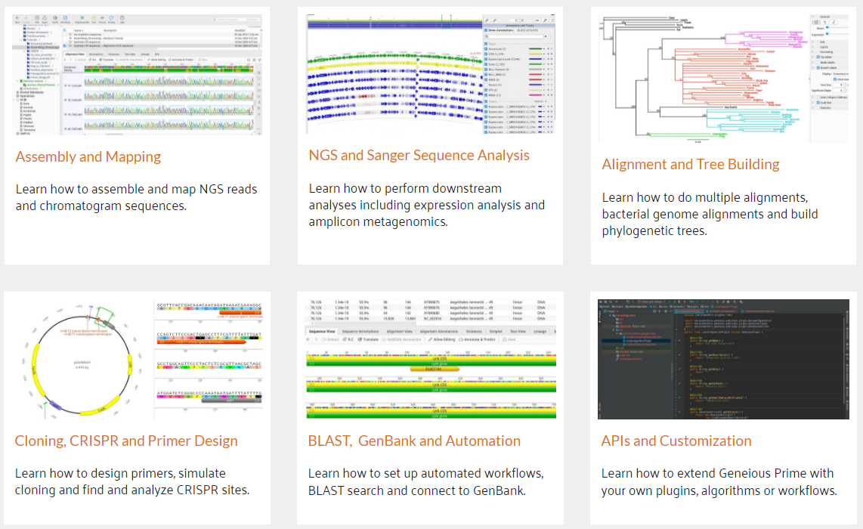
Geneious
Description of function/uses
Plugins
Tools > Plugins…
PhD examples (alignments/phylogenetic trees)
Fun

Slide 10
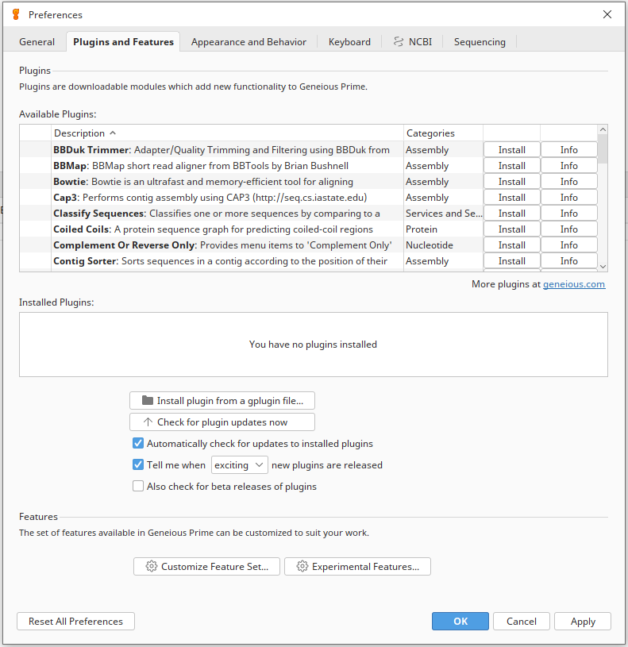
Geneious
Suite of tools for molecular biology and NGS tools
Plugins
Tools > Plugins…
Alignment, assembly, nucleotide analysis, phylogenetics, protein analysis

Slide 11
Geneious
Suite of tools for molecular biology and NGS tools
Plugins
Tools > Plugins…
Alignment, assembly, nucleotide analysis, phylogenetics, protein analysis
PhD examples (alignments/phylogenetic trees)

Slide 12
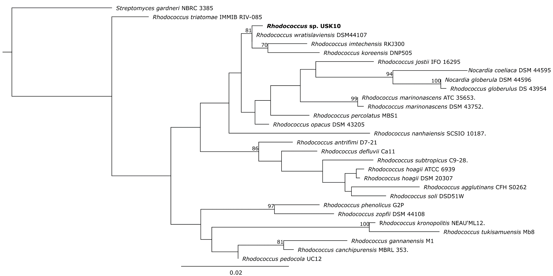
PhD Example
Import genome
Find 16S
BLAST
Alignment
RAxML plugin

Slide 13
Geneious
Suite of tools for molecular biology and NGS tools
Plugins
Tools > Plugins…
Alignment, assembly, nucleotide analysis, phylogenetics, protein analysis
PhD examples (alignments/phylogenetic trees)
Fun

Slide 14
Fun (Exercises)
GC content/nucleotide statistics (% of A/T/C/G)
How many CDS are annotated
How many with functional annotation?
Find 16S region
how many base pairs?
BLAST it
Open reading frames (ORF)
Search for specific genes of interest
EC number, UniProtKB

Slide 15
Answers - Listeria monocytogenes str. 4b F2365, complete genome
GC content/nucleotide statistics (% of A/T/C/G)
GC content: 38%
A: 31.1%
T: 30.9%
C: 19.1%
G: 18.9%

Slide 16
Answers - Listeria monocytogenes str. 4b F2365, complete genome
How many CDS are annotated
2,808
How many with functional annotation?
Hypothetical proteins: 820
Functional annotation: 1,988

Slide 17
Answers - Listeria monocytogenes str. 4b F2365, complete genome
Find 16S region
how many base pairs
Large: 2,928
Small: 1,547
BLAST it
Extract region (reverse complement)
Right click – BLAST…
does it match completely? Think of why it might be different. How can we be more sure of the true speciation/identity of the strain?)

Slide 18
Answers - Listeria monocytogenes str. 4b F2365, complete genome
Open reading frames (OPF)
# new? Look familiar?

Slide 19
Answers - Listeria monocytogenes str. 4b F2365, complete genome
Search for specific genes of interest
ActA
DltA
Etc…

Slide 20
Visualization
https://proksee.ca/

